Slide 1


Top 10 Home Staging Mistakes Sellers Make
www.stageandstylebyleigh.ca

Slide 2
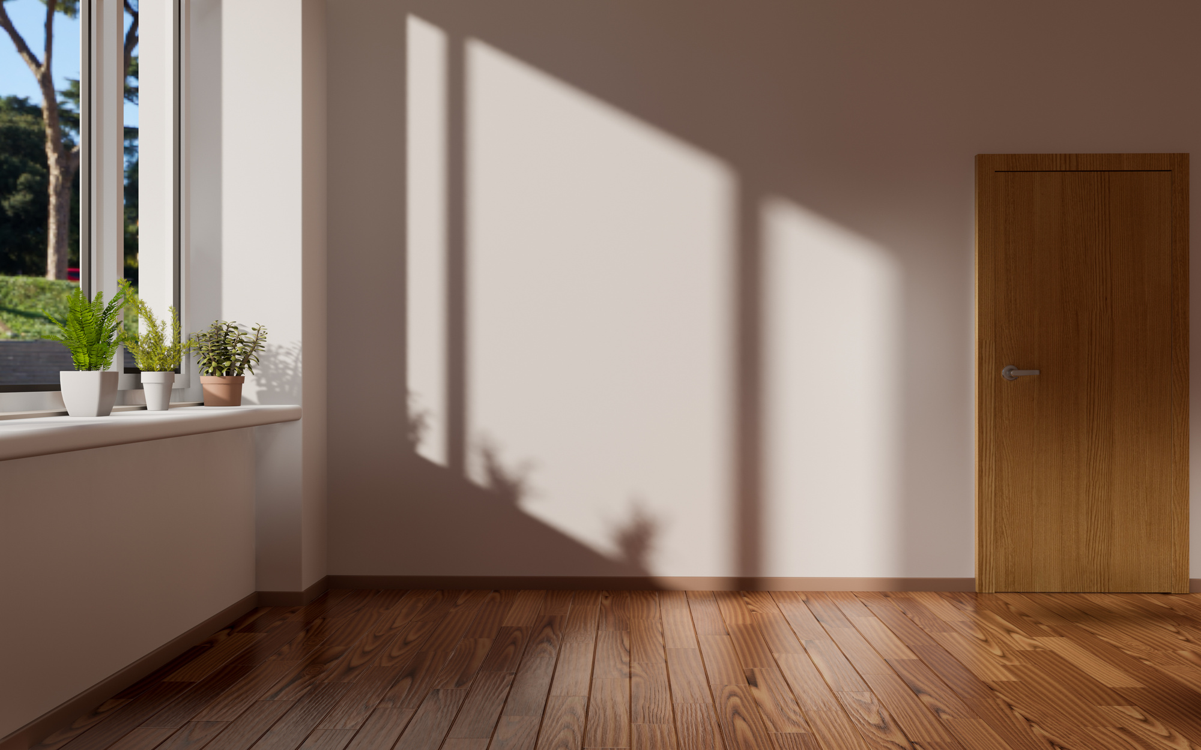
Vacant Rooms – Did you know?
Only 10% of buyers can visualize a space! Vacant rooms appear smaller to potential buyers and raise concerns regarding furniture placement.
Don’t lose out on 90% of the buyers – stage it!

Slide 3

Self-Staging – With access to so many resources with tips for selling your home, including TV, the Internet, and DIY books, it’s easy to misinterpret the information provided in these resources and apply these techniques incorrectly.
Every home is unique and should be staged as such.
Certified Home Staging Professionals are trained to deal with all types of challenging rooms and have the solutions to help your house make a lasting impression.

Slide 4

Staging With Random Furniture – When a space is missing the furniture that it needs to define it and fill it effectively, we often hear things such as “My mom has an extra coffee table” and “My friend said I could borrow some art”.
These pieces are intended to coordinate with their respective owners’ styles and furnishings and may appear out of place in your home. Use caution when borrowing any items.

Slide 5
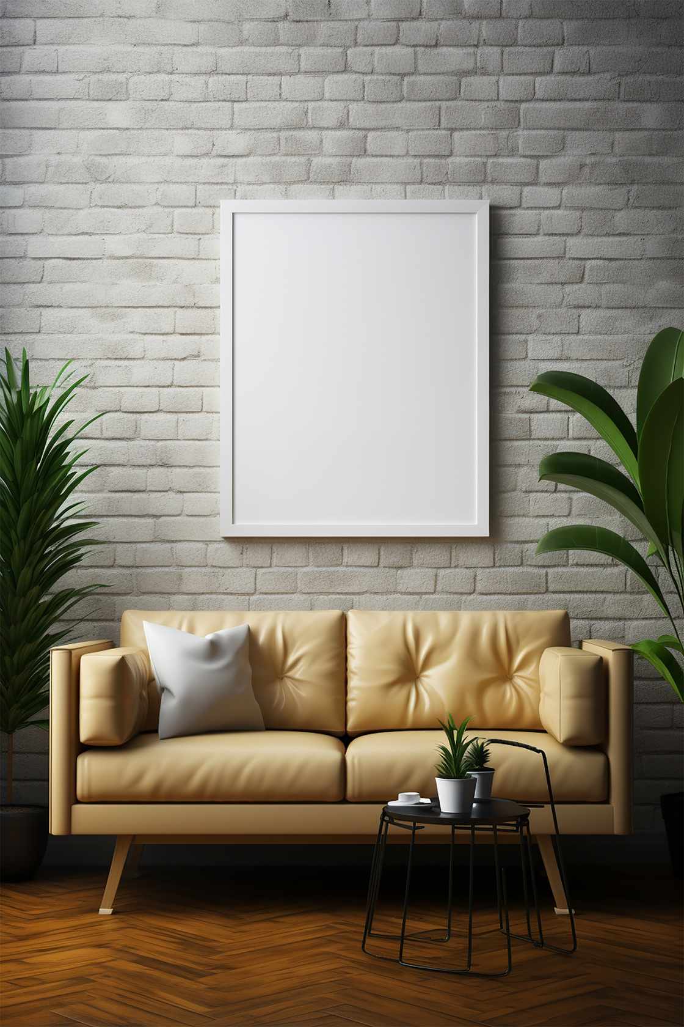
Bare Walls – Too often we are greeted with properties that lack any wall decorations. Homeowners commonly suffer from a fear of commitment – to artwork. Afraid to put holes in the walls until they find that “perfect piece”, they find themselves years later with an incomplete room.
Wall furnishings help to pull the room together and provide a warm, “cozy” look and feeling.
For selling purposes, be sure to avoid any personal wall pieces and instead swap these for more neutral artwork.

Slide 6

Staging AFTER Listing – You reach the greatest number of buyers within the first 2 weeks that the house is listed on the market – be sure that you make the best first impression possible by showing your house at it’s absolute finest from day one.

Slide 7
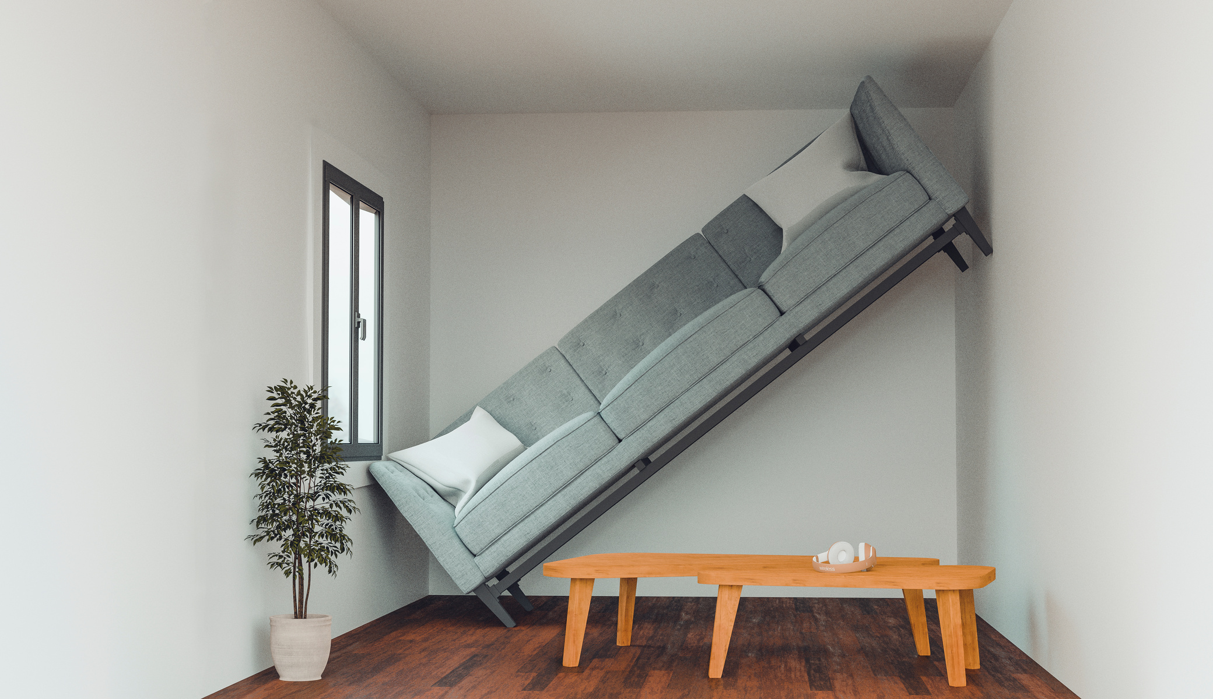
Too Much Furniture – When selling your home, less really is more. Ensure that furniture and other items are not interrupting the proper flow of the room. Too much furniture will make the room look smaller.
Remove the dresser or extra couch that doesn’t fit in the room and ensure that all walkways are clear.
Buyers will not notice that a piece of furniture is missing from a room, but they will notice a room that is furnished awkwardly.

Slide 8
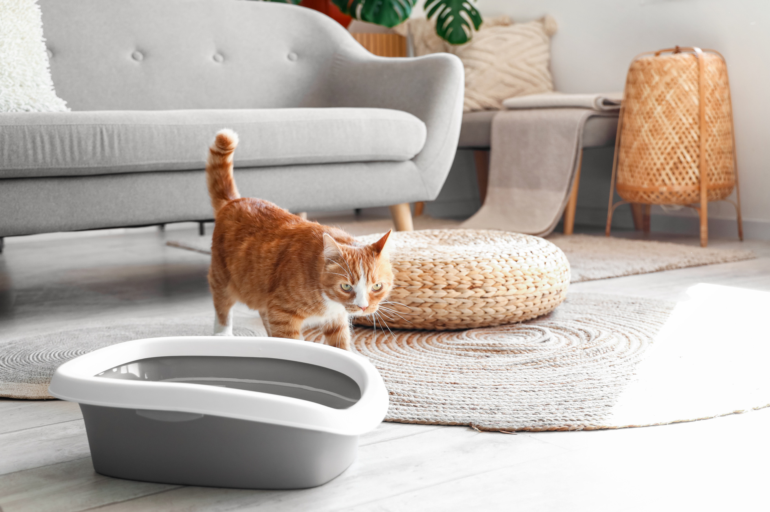
Odors – It’s often difficult to detect odors in your own home, but if you have pets, previous moisture damage, or smoke cigarettes or cigars in your house, these lingering odors will raise red flags with potential buyers.
Avoid covering these with artificial air fresheners and instead work to remove the source. Remove pets from the property if possible for the time the house is on the market, fix damaged areas, air out the house, paint the walls, and smoke outside.

Slide 9

Poor Listing Photos – If your Realtor does not include professional photography as a part of your listing package, consider investing in this yourself – 90% of home buyers shop online first!
Make sure your home is properly staged and prepared for photography. You’ve worked hard to set up your home to sell, be sure that this comes through with quality photos as well.
FYI – Professional photos are so important when marketing your home, that Stage and Style provides professional photos with every staging package.

Slide 10

DIY – Hire a professional – Realtors, mortgage brokers, lawyers and home stagers all have the training and skills needed to help you with your home buying and selling needs.
For updates or repairs, hire a skilled trade professional such as a plumber, electrician, or general contractor. DIY has its place, but when it comes to selling your largest investment, it’s best to leave it to the pros.

Slide 11

Cleanliness – When listing your home for sale, ensure that it is white glove clean before your first showing. This is exactly how it sounds – leave no stone unturned and clean every surface, nook, and cranny.

Slide 12
Ready to Make Your Home Stand Out?
Don't let common staging mistakes cost you potential buyers! Trust the professionals at **Stage and Style by Leigh** to create a stunning, market-ready home that sells.
Contact us today for expert staging services and personalized advice:
📞 780-715-8949
📧 info@stageandstylebyleigh.ca
🌐 www.stageandstylebyleigh.ca
Let us help you make the best first impression and maximize your home's value. Schedule your consultation now!

